Slide 1

Animal Migration and Climate Change
Gaurang Solanki, Md Mahfuz Alam,
Dallas Diaz, Kennedy Jasso

Slide 2
Is Climate Change Affecting Arctic Fox Migration in the Canadian Arctic Archipelago?
Main Project Objective: to determine whether the migration of the arctic fox on Bylot Island in Greenland is influenced by climate change
Factors of Focus:
CO₂ Emissions
Sea Ice Area
Temperature
Food Insecurity

Slide 3
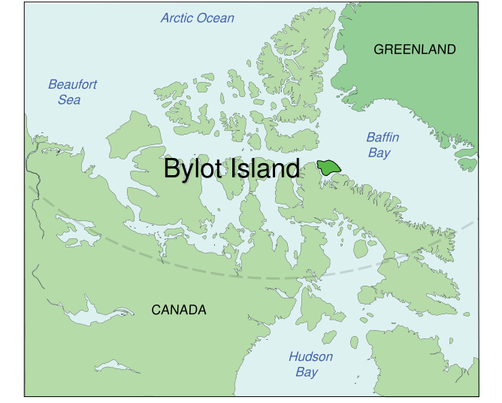

Background Information
The animal proxy originates from
Bylot Island
Why was this location chosen?
Low Human Population
Less Environmental Degradation
Noticeable Effect of Climate Change
Protected Land
Illegality of Hunting
Source: http://larusology.blogspot.com/2010_11_01_archive.html
Notes:
Having Bylot Island as the location eliminates many covariates.

Slide 4
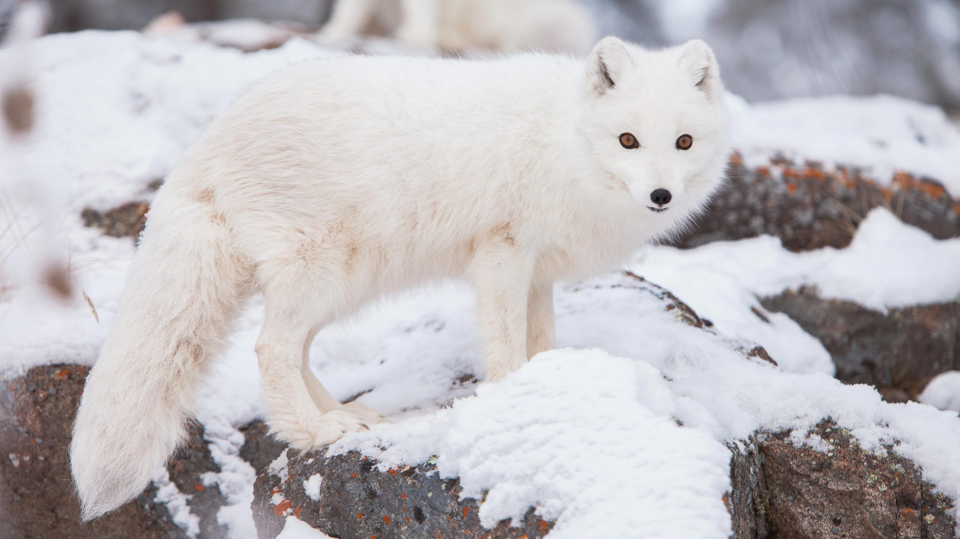
Background Information (cont.)
Animal Proxy:
Arctic Fox
Predator of the Arctic Tundra
Food sources: lemmings, hares, birds, fish, etc.
Described as a "seasonal migrant"*
May travel during the winter, but also tend to stay local around the area of Bylot Island
Stationary (Confined to Surrounding Area)
Article: Lai, S., Bêty, J., & Berteaux, D. (2016). Movement tactics of a mobile predator in a meta-ecosystem with fluctuating resources: The arctic fox in the High Arctic. Oikos, 126(7), 937–947. https://doi.org/10.1111/oik.03948 *
Source: https://yukonwildlife.ca/wildlife/arctic-fox/2020-05-cute-but-tough-arctic-fox/

Slide 5
Climate Data

Slide 6
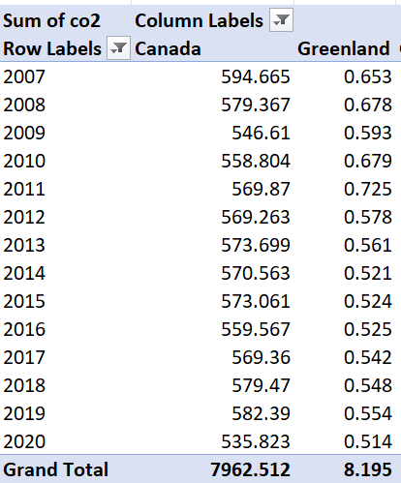
Factor 1: Co₂
The first factor we considered was Co₂ and greenhouse gases.
Using data and a pivot table, we were able to extract a set of values from the data set that allowed us to draw conclusions.
Source: https://github.com/owid/co2-data

Slide 7
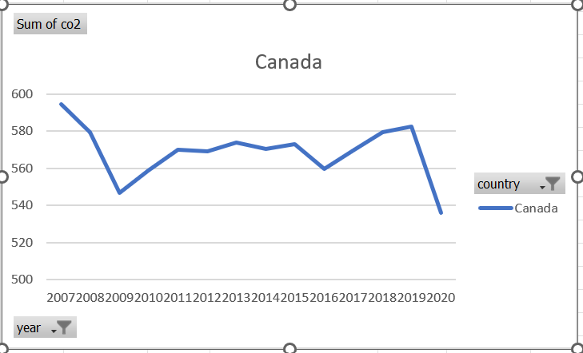
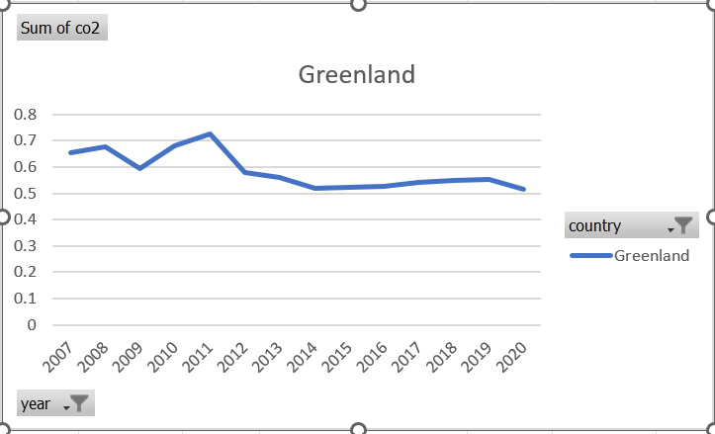
Factor 1: Co₂
Here is a graphical representation of the pivot table of the two countries surrounding the area of focus for our animal migration projects.
We see that Greenland and Canada both had a decrease in Co₂ levels (pay attention to the axes)
Because of this decrease for both countries, we believe this could have been a factor in the directions the animals were migrating.
More testing would need to be done but it is a good start.

Slide 8
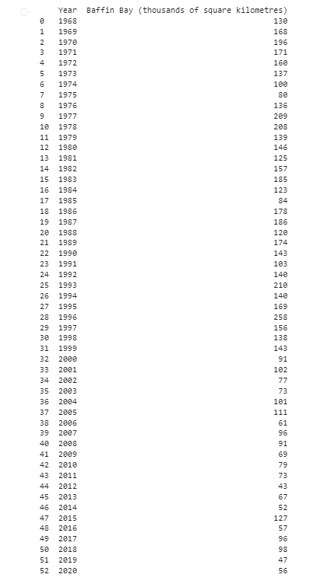
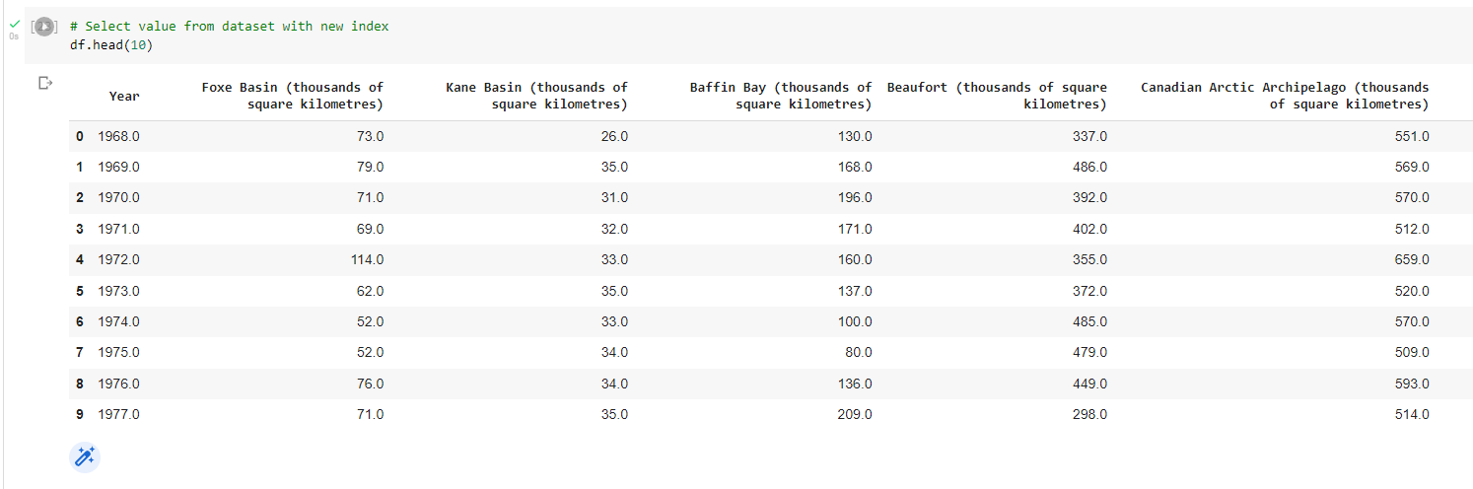
Sea Ice Area Data
The Sea ice in Canada indicators are based on the sea ice area data provided by Environment and Climate Change Canada's Climate Research Division.
All sub-regions exhibit statistically significant decreasing trends in summer sea ice area over the 1968-2020 period.
Decreasing sea ice has a direct impact on the livelihoods and health of Indigenous peoples and northern communities in Canada. For example, it makes travel across sea ice less predictable and more dangerous, which can reduce access to traditional hunting and harvesting activities.
Decreasing sea ice is also leading to shorelines being more exposed to waves and storm surges, and more prone to erosion and flooding. These same changes impact animals that use the sea ice.

Slide 9
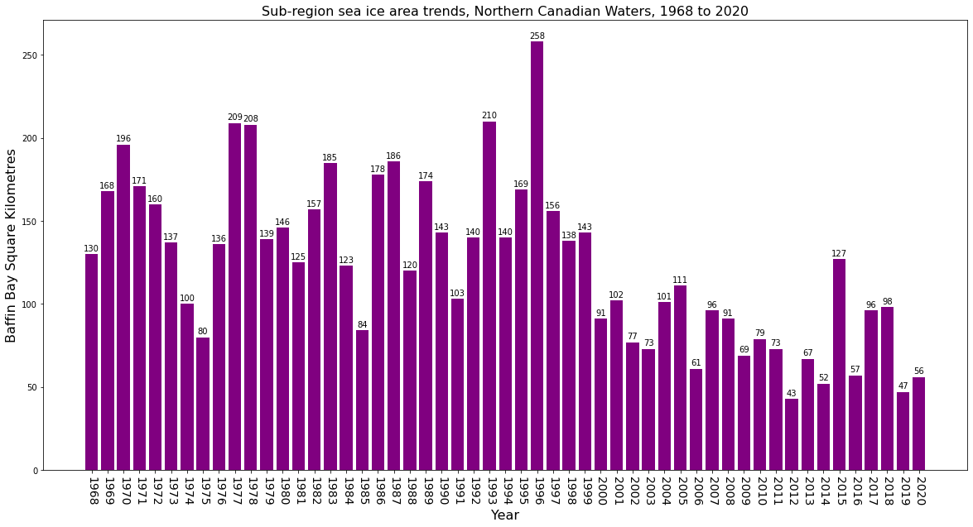
Sea Ice Area
In this bar graph, the y-axis refers to the area of sea ice (in square kilometers) for Baffin Bay and x-axis refers to the "Year".
Over the years, we can see the sea ice area has been deceased in year between 1968-2020 in Baffin area.
The lowest sea ice area occurred in 2012, with 43 square kilometer.

Slide 10
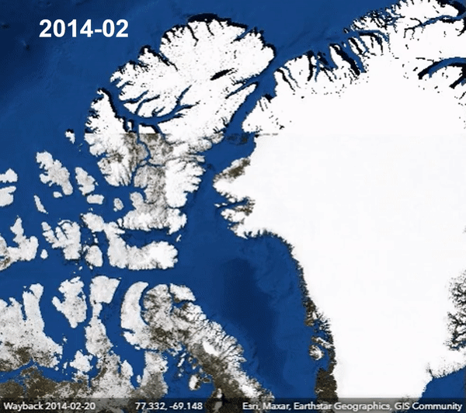
Sea Ice Area of Baffin Bay
In this gif image, we can see that how the ice area is affected in the date range we collected this from "World Imagery Wayback" between the year range of 2014 –2022.
Overall, the total amount of area covered by sea ice is progressively decreasing.
Source: https://livingatlas.arcgis.com/wayback/#active=7110&ext=143.96513,-40.76783,172.44169,84.95305

Slide 11
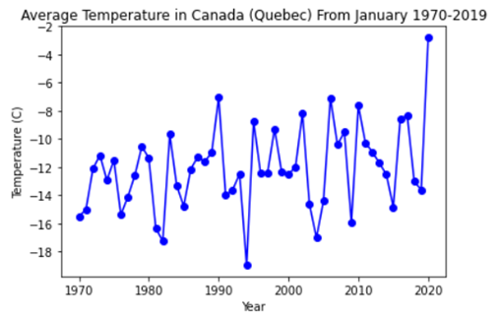
Temperature
the Arctic is warming four times faster than the global average.
"The Arctic is warming four times faster than the global average."*
The line graph shows that the temperature is increasing at a low rate with some fluctuations.
It is consistent with how the average annual temperature in Canada increased by 1.7 °C from 1948 to 2016.**
Even a small temperature increase is detrimental to the environment.
https://www.science.org/content/article/arctic-warming-four-times-faster-rest-world*
https://www.canada.ca/en/environment-climate-change/services/climate-change/canadian-centre-climate-services/basics/trends-projections/changes-temperature.html**
Source of Data: https://www.kaggle.com/datasets/aturner374/eighty-years-of-canadian-climate-data, (originally from) https://climate-change.canada.ca/climate-data/#/daily-climate-data

Slide 12
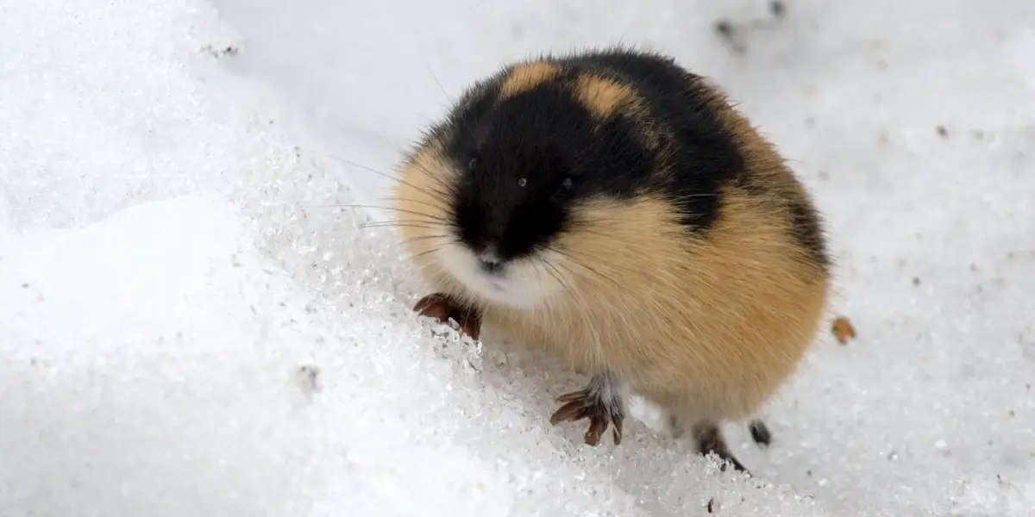
Food Insecurity
Food sources are heavily impacted by factors of climate change.
The lemming populations are particularly impacted by the climate.
Lemmings create nests and burrows in the top layers of snow.
Due to climate change, snow melts and refreezes during the winter.
This creates a hard top layer that lemmings cannot penetrate.
In turn, the lemming population is negatively impacted.*
Lemming (Main Food Source of Arctic Foxes)
https://www.businessinsider.com/lemmings-dont-commit-suicide-off-cliffs-2016-2
Article: Domine, F., Gauthier, G., Vionnet, V., Fauteux, D., Dumont, M., & Barrere, M. (2018). Snow physical properties may be a significant determinant of lemming population dynamics in the High Arctic. Arctic Science, 4(4), 813–826. https://doi.org/10.1139/as-2018-0008*

Slide 13
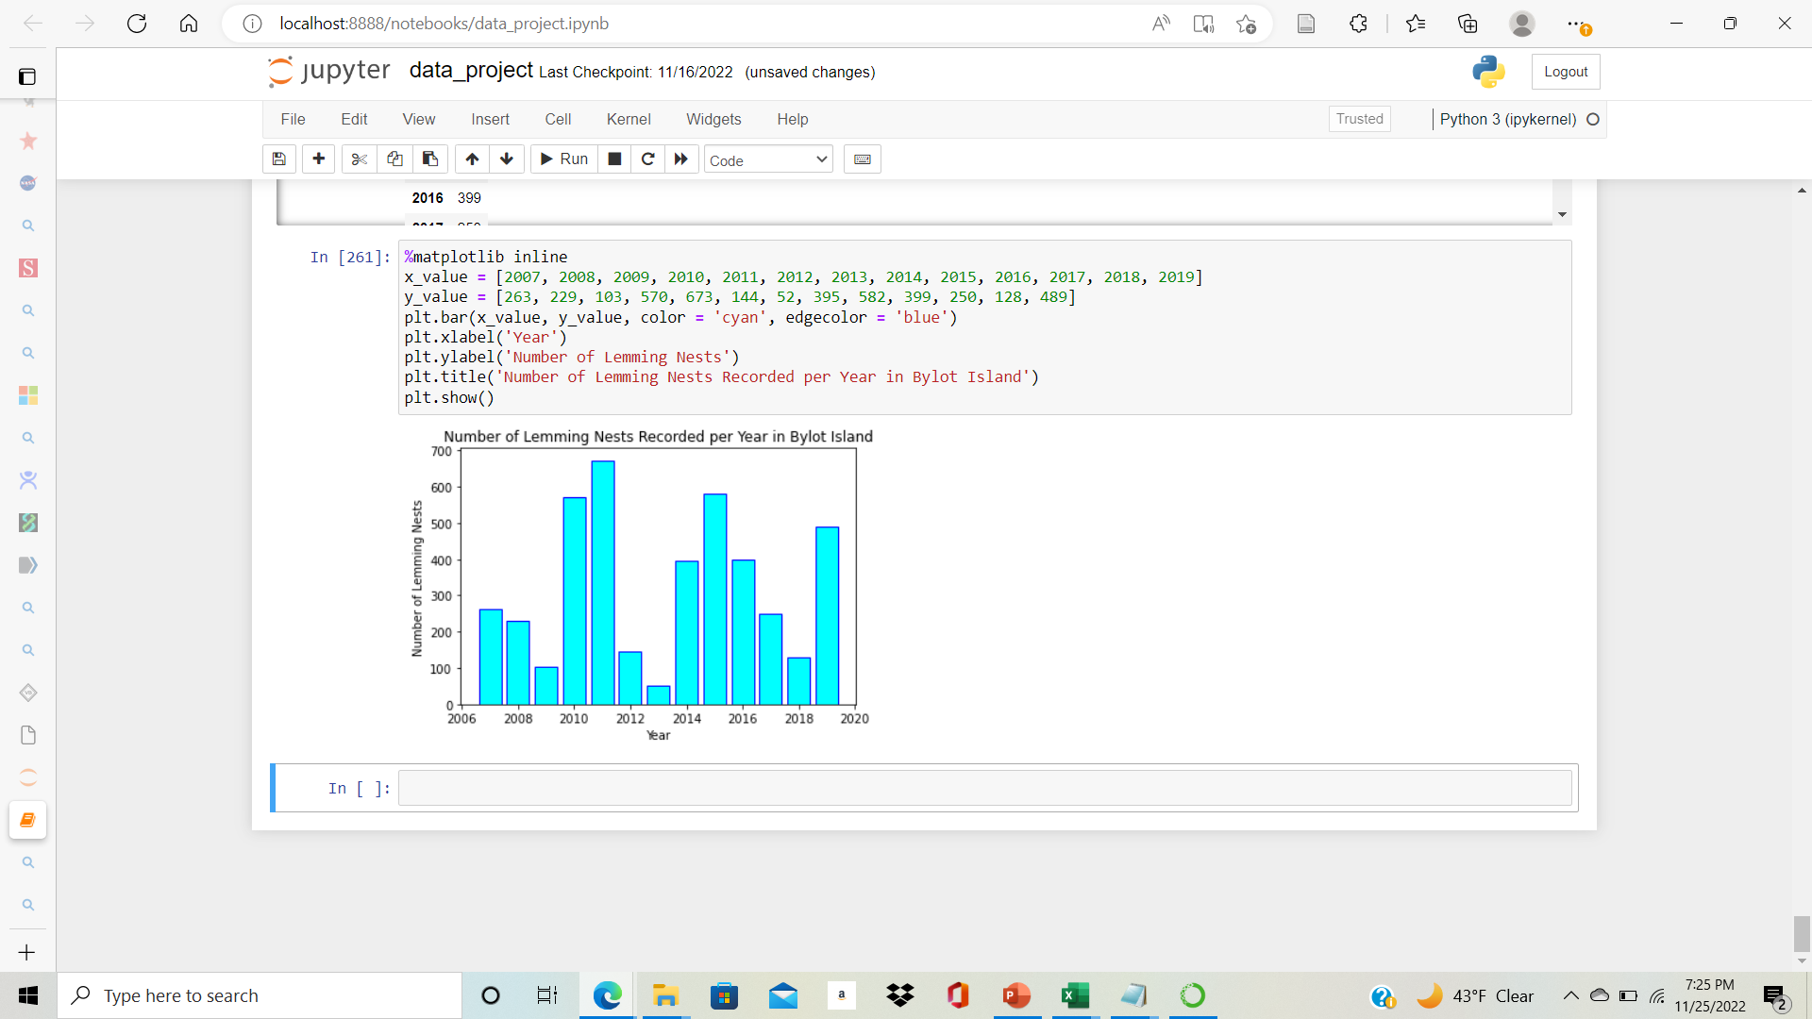
Food Insecurity
This is a bar graph of the number of lemming nests recorded in Bylot Island per the year range: 2007-2019.
This is used to approximate the lemming populations.
Lemmings are well-known to have cyclic populations. Every four years, there is a large increase in population.*
The bar graph fluctuations is consistent with the lemming cyclic population.
https://besjournals.onlinelibrary.wiley.com/doi/full/10.1111/1365-2656.12385*
Source of Data: https://nordicana.cen.ulaval.ca/dpage.aspx?doi=45400AW-9891BD76704C4CE2

Slide 14
Migration Visualization

Slide 15
Main Data Source
•Arctic fox Bylot – Argos tracking
Link to original data source on movebank.org
•Summary: Characterization of large-scale movements in the Arctic fox through Argos satellite telemetry
•Duration: 2007 to 2021
•Number of Foxes: 170
•Total Number of Records: 64489
•Originally, the dataset had 38 columns but only four were applicable:
location-lat (Location: Latitude)
location-long (Location: Longitude)
individual-local-identifier (Identifier for each Fox)
timestamp

Slide 16
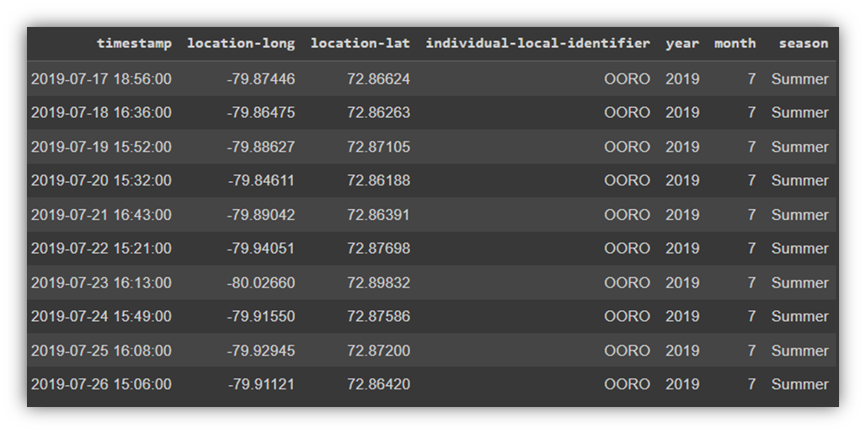
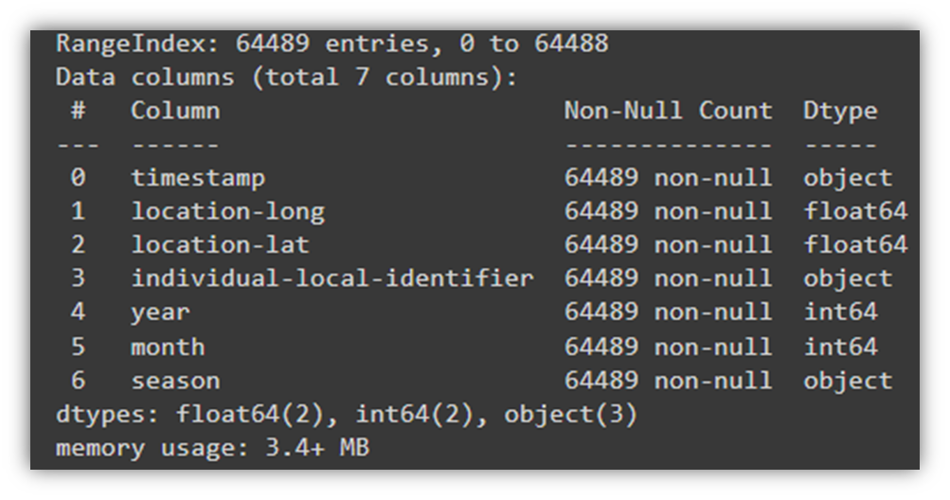
Data Cleaning and Wrangling
•After cleaning we are left with columns:
•Longitude
•Latitude
•Timestamp
•Fox Identifier
•Converted ‘Timestamp’ datatype into Date Time format
•Extracted new columns ‘year’ & ‘month’ from ‘Timestamp’
•Added new column ‘season’ representing different seasons based on corresponding months:
Spring - March, April, May Summer - June, July, and August Fall - September, October, and November Winter - December, January, and February

Slide 17
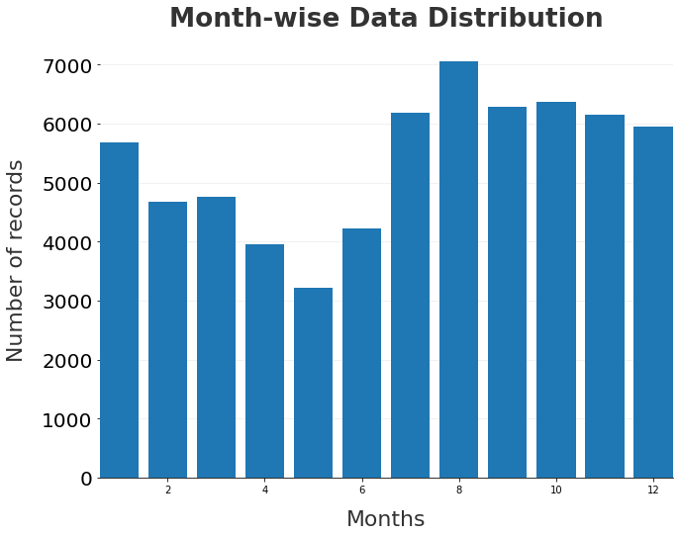
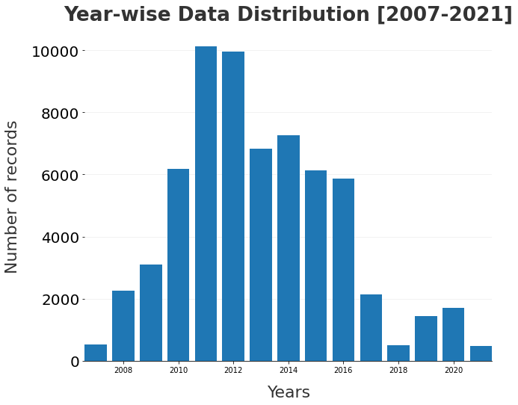
Data Distribution
Month-Wise:
Largest: August has the greatest number of records at about 7000.
Smallest: May has the lowest number of records at about 3300.
Year-Wise:
Largest: 2011 and 2012 have the greatest number of records at about 10000.
Smallest: 2007, 2018, and 2021 have the lowest number of records at <1000.

Slide 18
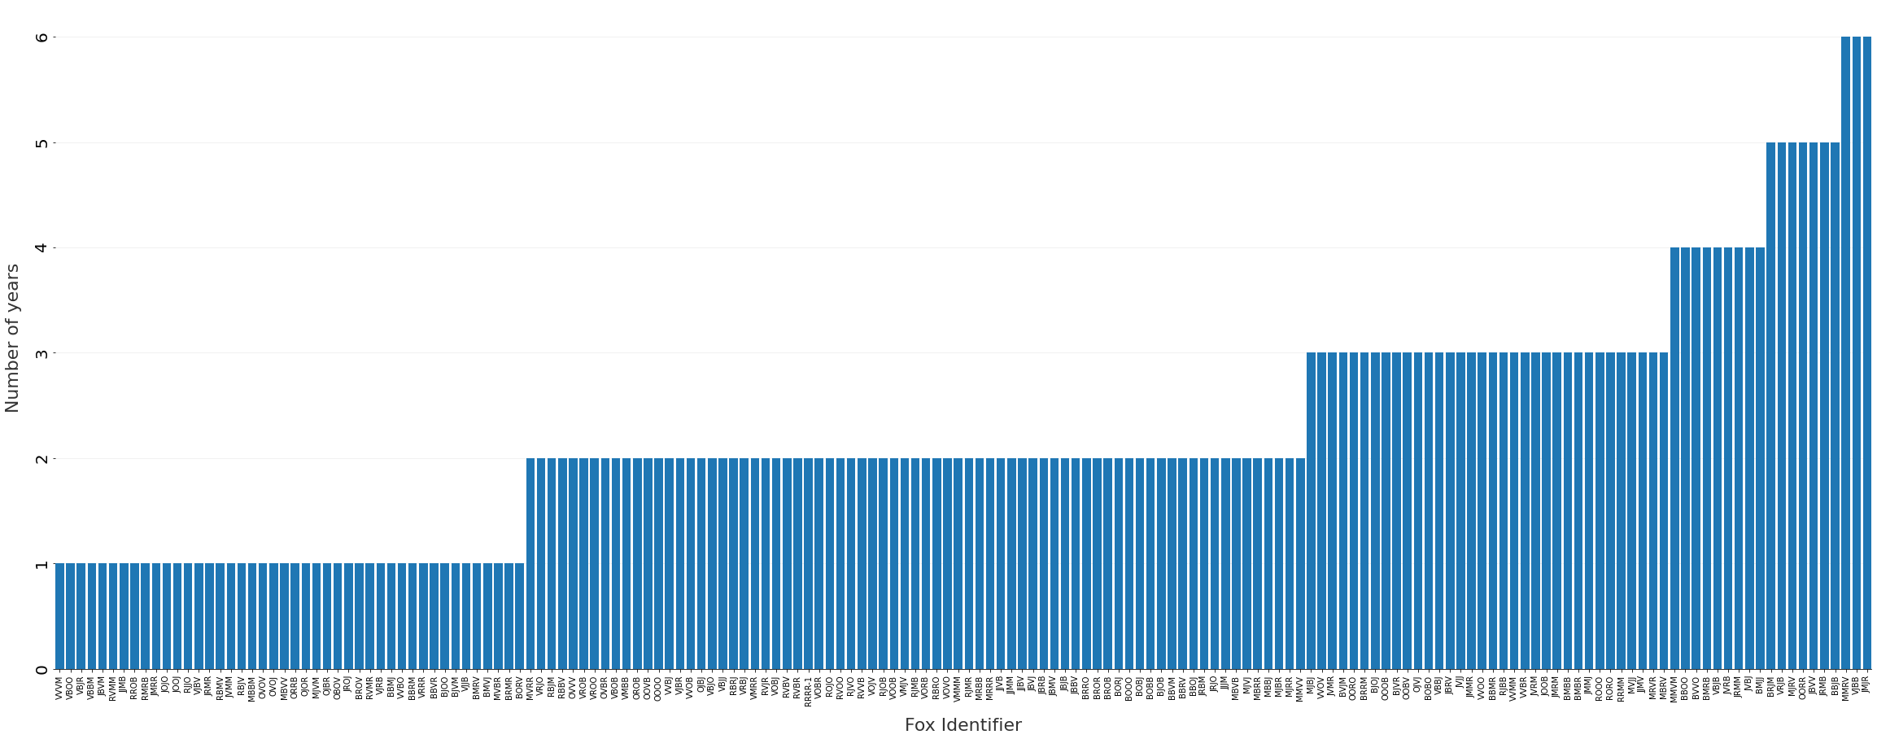
What is the Longest Number of Years a Specific Fox has been Recorded?
Three foxes were recorded for six years. (The longest number of years)
73 foxes were recorded for two years. (The average number of years)
44 foxes were recorded for only one year. (The smallest number of years)
3
7
9
34
73
44

Slide 19
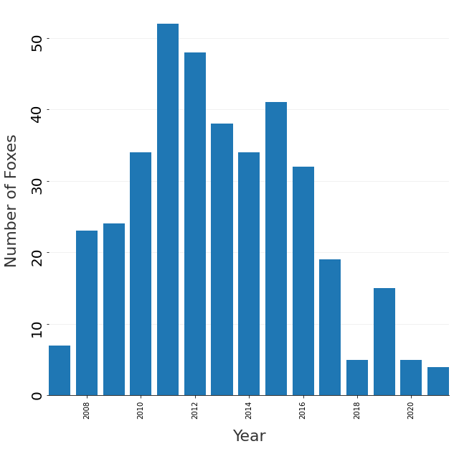
What is the Number of Foxes Tracked Every Year?
The maximum number of foxes being tracked in the year 2011, and the least number in 2021.
If we look closely, this graph is correlated to the year-wise data distribution of records graph.
As number of foxes increases, number of data points increases.

Slide 20
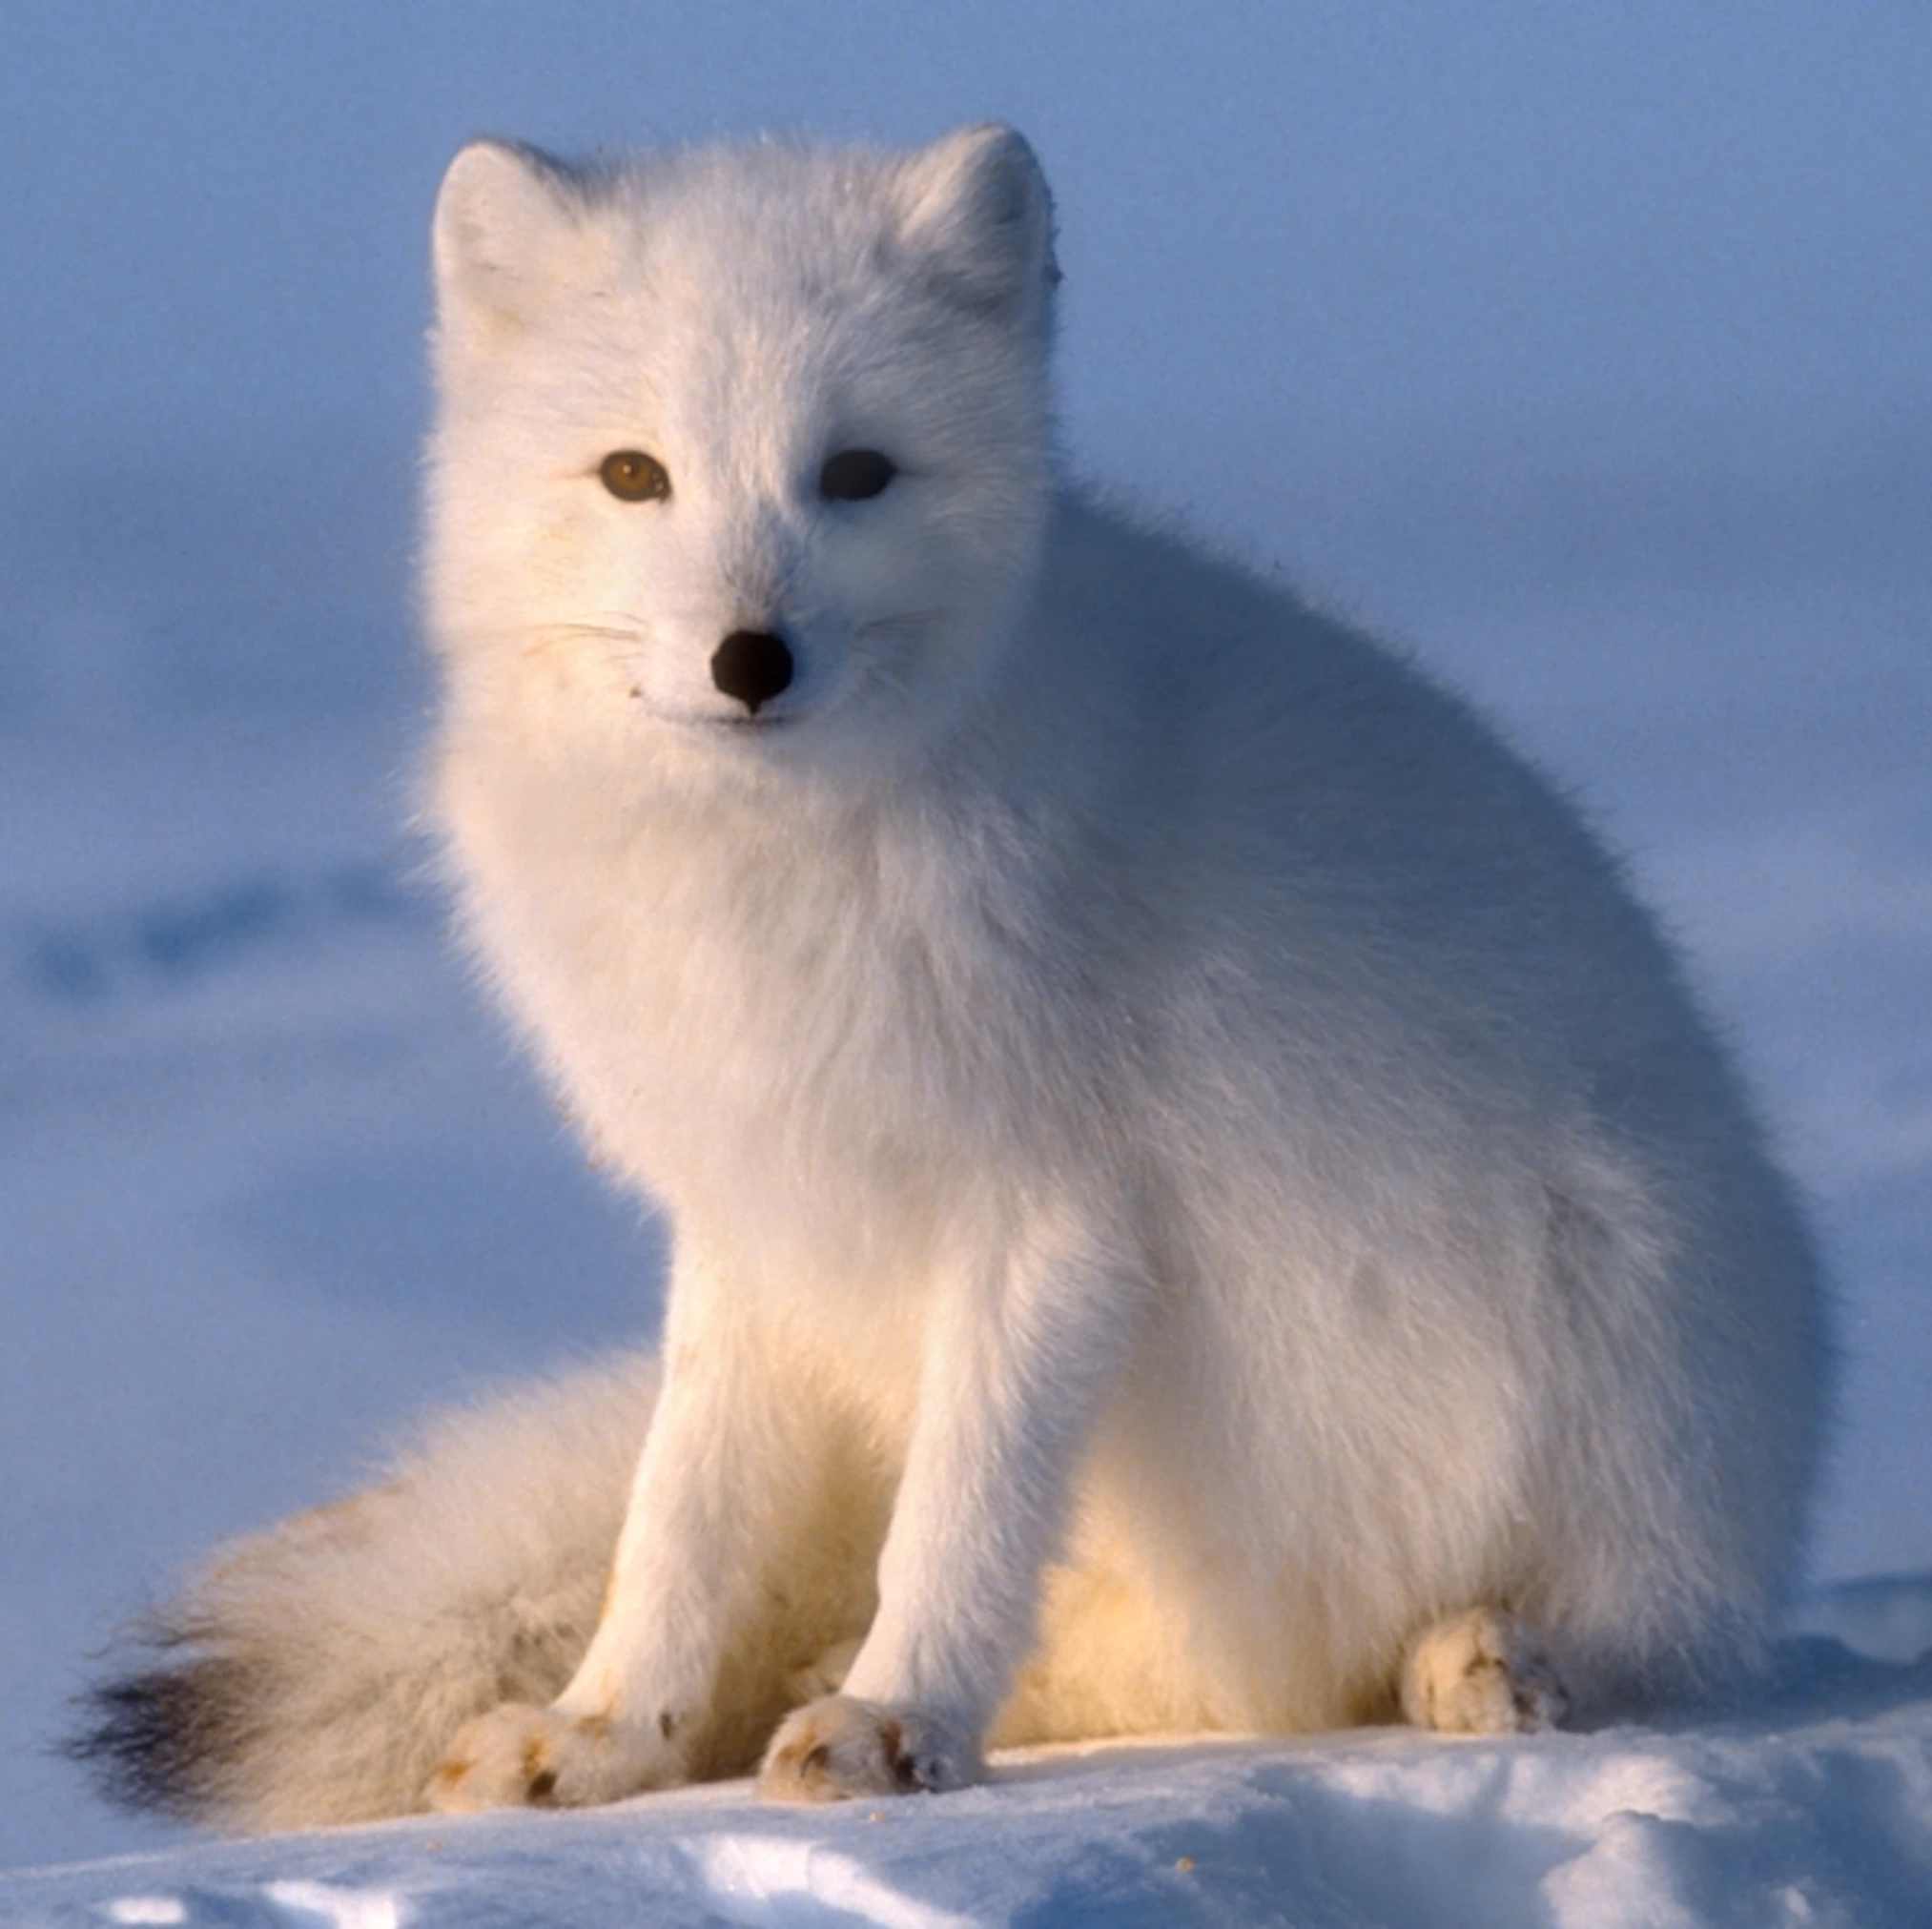
Migration Visualization
Why do Arctic foxes migrate?
The Arctic fox is a "seasonal migrant" or nomadic. It moves from place to place looking for food.*
When?
The Arctic fox migrates seaward in fall and early winter and will reverse movement in late winter and early spring.**
Article: Lai, S., Bêty, J., & Berteaux, D. (2016). Movement tactics of a mobile predator in a meta-ecosystem with fluctuating resources: The arctic fox in the High Arctic. Oikos, 126(7), 937–947. https://doi.org/10.1111/oik.03948 *
https://ypte.org.uk/factsheets/fox-arctic/arctic-fox-habits**

Slide 21
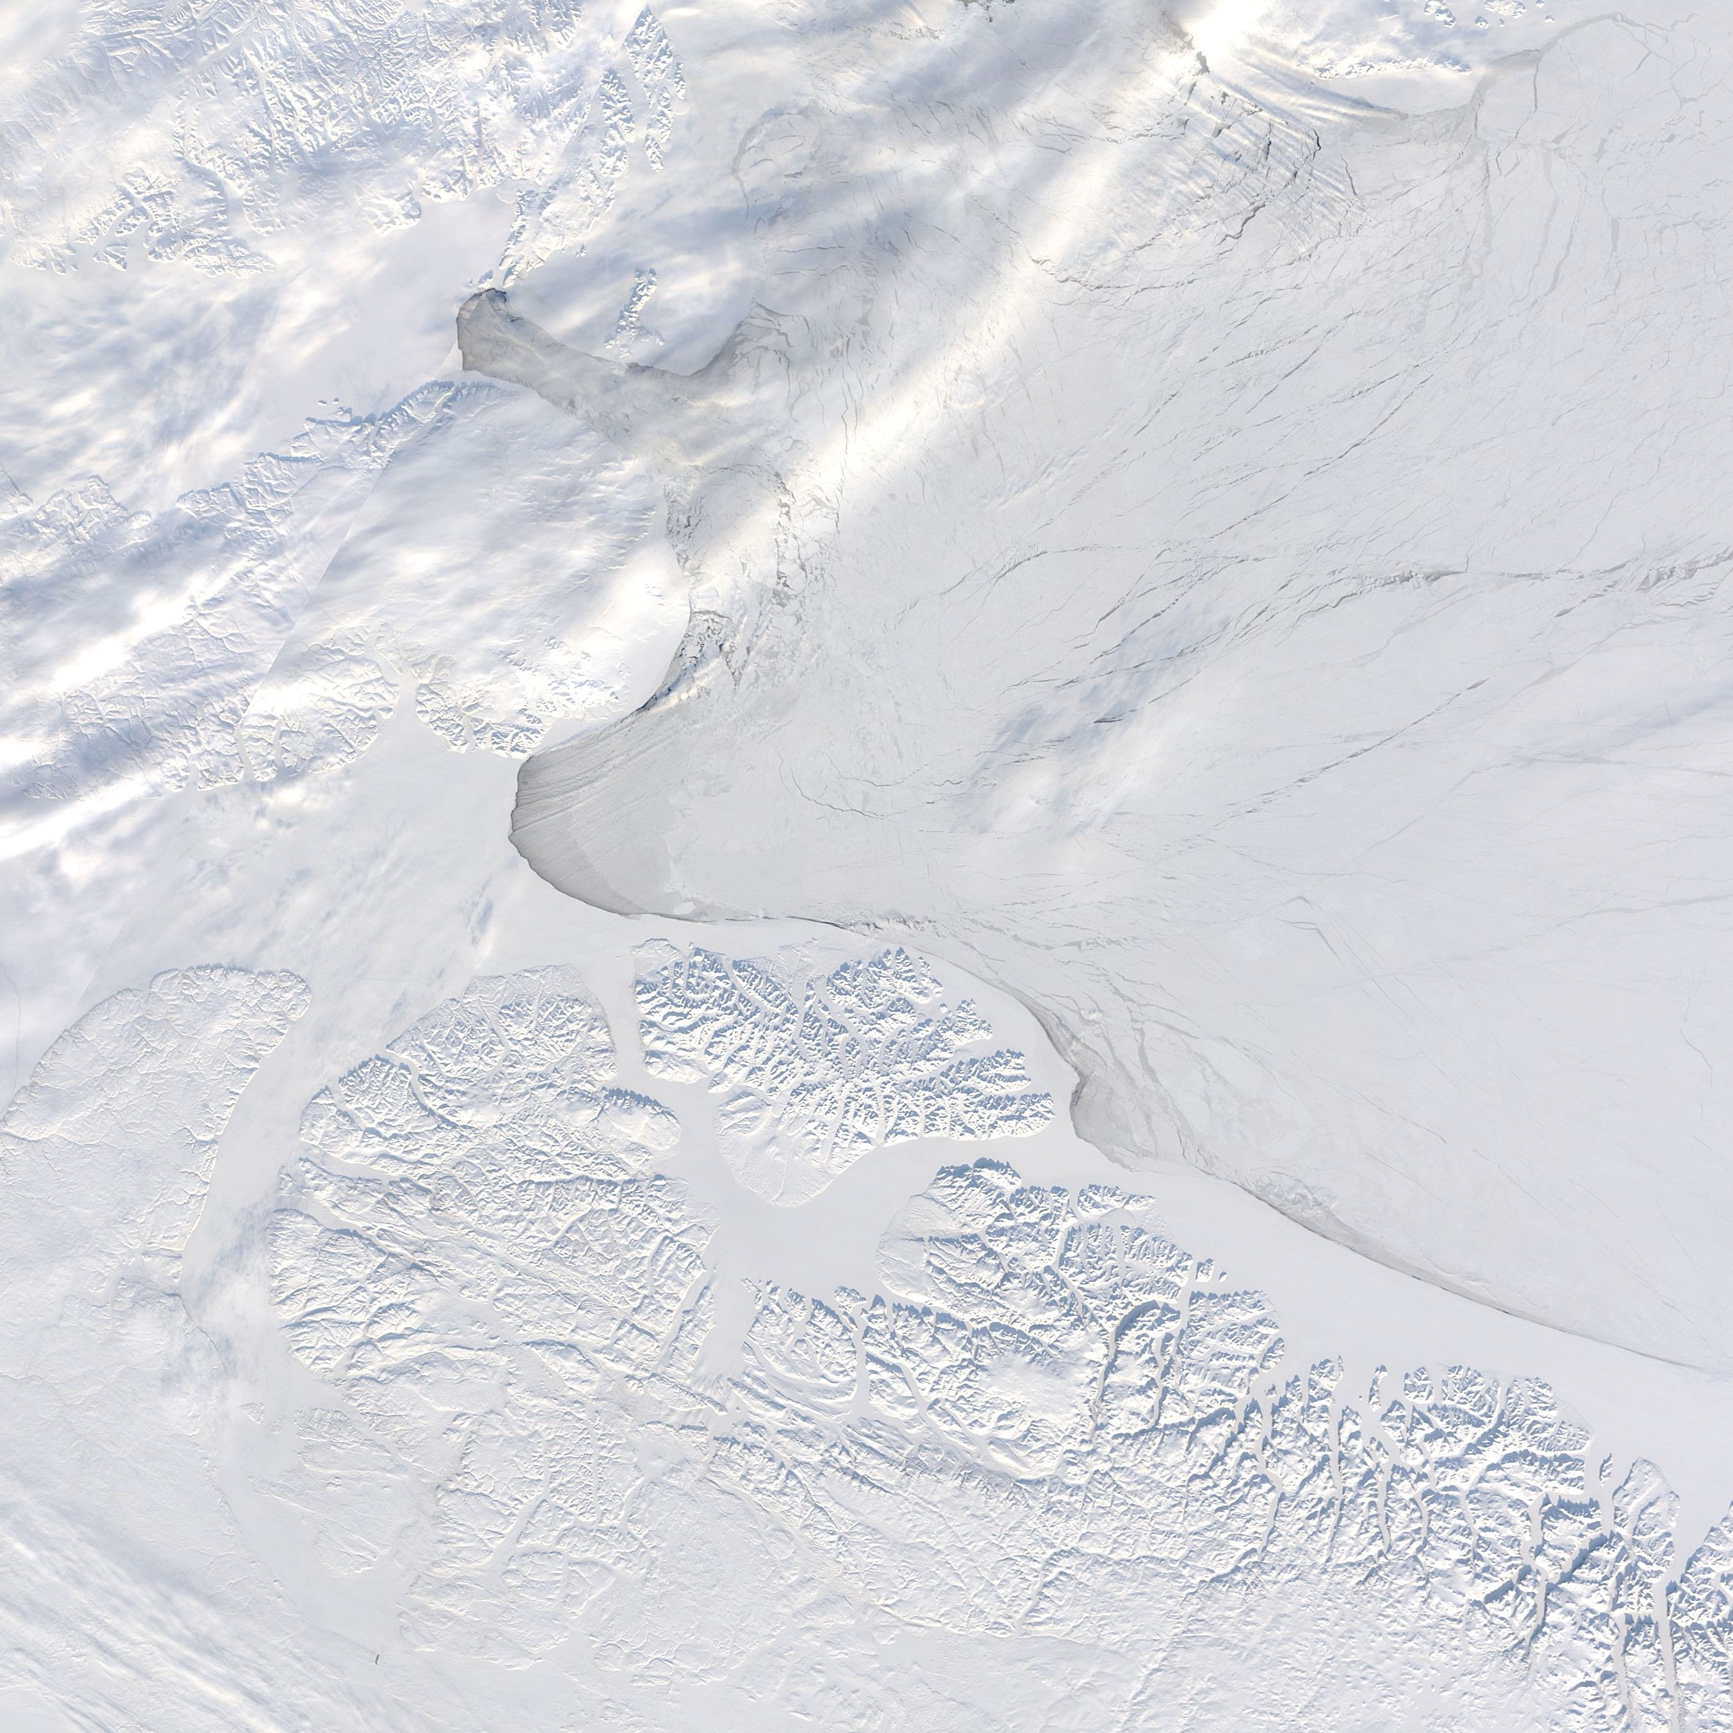
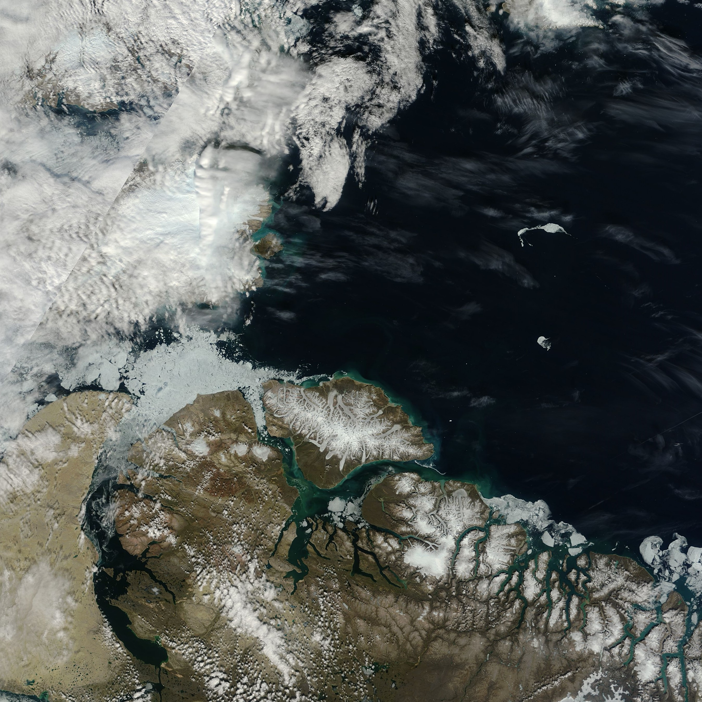
Bylot Island during Winter (March 2012)
Bylot Island during Summer (July 2012)
During the summer months, Arctic foxes collect a surplus of food and carry it back to their dens to bury and store.*
During winter, Arctic foxes do sometimes move to other regions when and if the population of their prey reduces or fluctuates in the winter.**
Images: https://earthobservatory.nasa.gov/images/79813/bylot-island-in-winter-and-summer
*Source: https://www.biologicaldiversity.org/species/mammals/Arctic_fox/natural_history.html#:~:text=During%20the%20summer%20months%2C%20Arctic,the%20remains%20of%20their%20kills.
**source: https://rangerplanet.com/do-arctic-foxes-hibernate-winter-habits-arctic-fox/

Slide 22
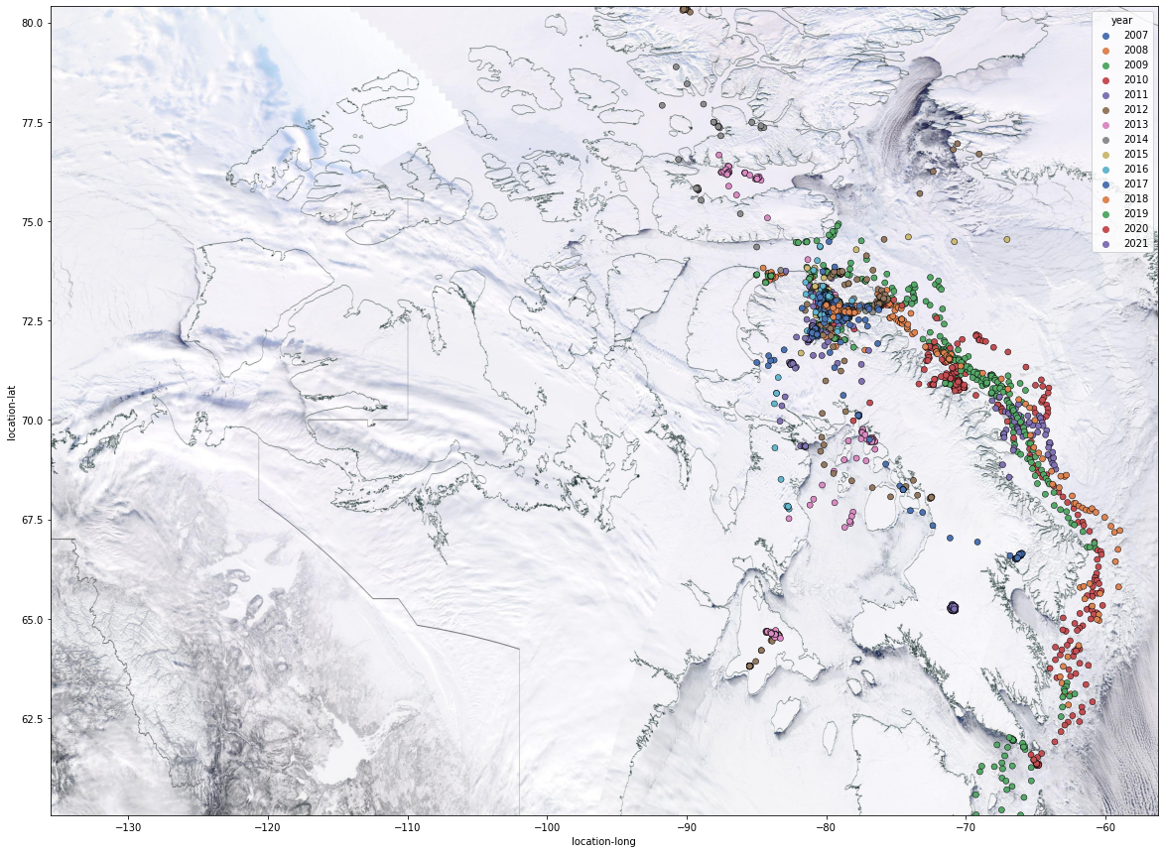
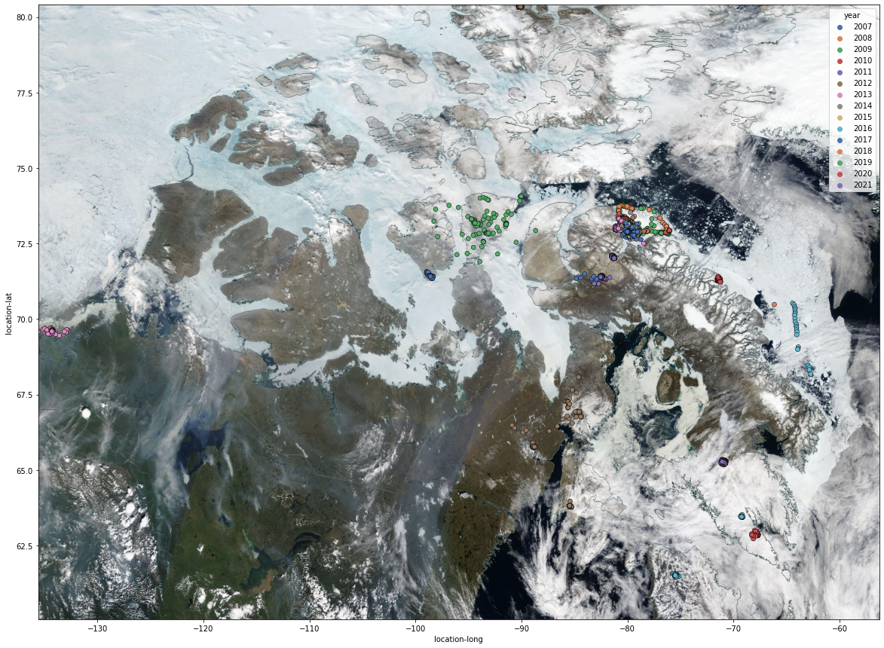
Movement of Foxes in Winter vs Summer over the Years
Bylot Island
Bylot Island
Winter Months: November, December, January, and February
Foxes migrating through costal area and sea ice looking for their main food, lemmings, or alternate marine food.
We can see that locations are spread-out, which means foxes travel further from their local territory during winter.
Summer Months : June, July, August, and September
Almost all foxes are on the land, and fewer are on sea ice.
We see many clusters (red circles), and not as many foxes are spread-out, which likely means that foxes stay in dens during summer.

Slide 23
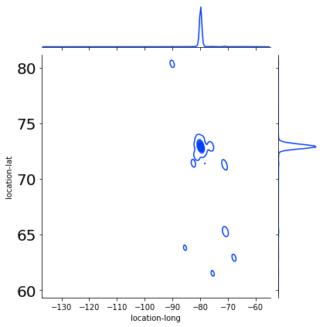
Distribution Plot to Identify Home/Local Territory and Other Hotspots
We can identify the local territory and other hotspots where foxes reside using Joint plot.
In given joint plot, x-axis and y-axis are longitude and latitude distribution, Respectively.
From graph we can say that most foxes have been recorder near –80° longitude coordinates and near 73° latitude coordinates.
Therefore, It is safe to say that outer line around the dense dot is their local territory.
Also, we can see few circles at lower latitude, those are some hotspots formed when many foxes started moving towards south-east after 2015.
Let's see in interactive map.
Bylot Island

Slide 24
Interactive Map to Analyze Movement of Foxes over the Years
Based on their three movement types identified*:
Resident – foxes remain in their territories with possible commuting trips.
Loop Migrant - foxes leave for a least one loop migration and return to their territory
Nomad Migrant - foxes leave and do not return to their territory before summer starts or die while undertaking a nomadic movement
Let's visualize their movements over the years
Click here to download interactive map
PowerPoint does not allow the full interactive map to be implemented, and thus it needs to be accessed through an outside source.
*Source: https://onlinelibrary.wiley.com/doi/10.1111/oik.03948

Slide 25
Reflections

Slide 26
Challenges With Data
There is a deficiency of data sets that directly apply to the Canadian Artic Archipelago or animals from the area.
Often, it is necessary that data sets for lower Canada or Greenland (which is a neighboring country) act as a surrogate
Arctic foxes live relatively short lives at an average of three years.*
None of the arctic foxes appear in every year of the migration data set.
The migration visualization needs to be perceived as a sum rather than individual arctic foxes.
https://www.wwf.org.uk/learn/fascinating-facts/arctic-fox*

Slide 27
Challenges With Data (cont.)
No data sets could be found with the complete lemming populations in the Canadian Arctic Archipelago.
Generally, research studies into Arctic lemmings use counts of lemming nests to estimate the overall population.
Lemmings also historically have odd population booms every four years that can make interpretations difficult.
In our case, they did seem to correlate with the migration visualizations of the Arctic foxes.
Gathering Co₂ data from a more reliable source.
The data that was collected was from large data hubs and websites but gathering the data ourselves or from a government source would prove it to be more reliable for making conclusions.

Slide 28
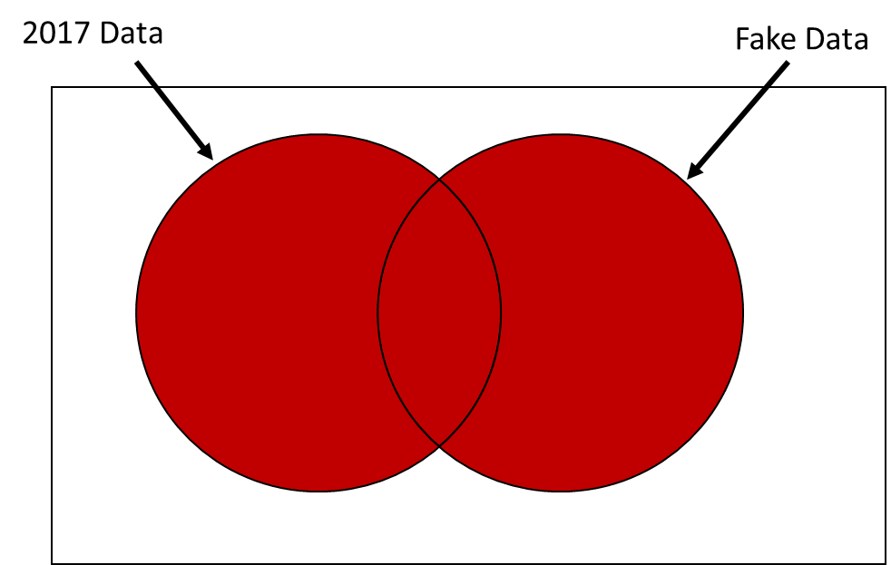
Challenges With Visualization
No clear satellite imagery was found that can be cropped and downloaded by coordinates
Used NASA Worldview snapshots to get snapshots of Region of interest which were used as background of scatter plots.
Had to manually browse through multiple dates to get clear (without clouds covering ROI) snapshots.
Plotly animation(used in Interactive graph) required constant number of unique fox Ids every frame(In this case, every year)
There are limitations with plotly animation(used in interactive graph), It expect constant number of unique fox Ids every year, and data set does not consist of same number of unique fox ids every year. (refer slide 19)
Issue was solved by using fake data that contain 170 rows, each row has unique Fox Id, where longitude and latitude equal to 0. Performed Full outer join on Main data and Fake data for every year.
For example, In 2017, out of 170 unique foxes we had data from only 17. Perform full outer join and get fake data (one row for each fox) of other 153 foxes.

Slide 29
Why Does It Matter?
Increasing temperature and increasing CO₂ (which in turn increases temperature) are causing food sources to decrease.
For example, high temperature during the winter causes snow to melt and then later refreeze.
This causes the snow to refreeze with a sturdier surface. Lemmings have difficulty building nests or burrows.*
As a result, lemming populations decrease.
Article: Domine, F., Gauthier, G., Vionnet, V., Fauteux, D., Dumont, M., & Barrere, M. (2018). Snow physical properties may be a significant determinant of lemming population dynamics in the High Arctic. Arctic Science, 4(4), 813–826. https://doi.org/10.1139/as-2018-0008*

Slide 30
Why Does It Matter? (cont.)
Increasing temperature causes sea ice to decrease in thickness and overall area.
Arctic foxes use sea ice to migrate between different areas.
Less sea ice decreases the Arctic foxes' access to food sources.
Arctic foxes are also now more isolated on specific land areas.
The isolation has been found to decrease genetic diversity (and increase inbreeding), and thus it causes Artic foxes to be more susceptible to illness.*
The overall Arctic fox population suffers as a result.
Article: Bowdoin College. (2021). Arctic Foxes in a Changing Environment. Managing the Effects of Climate Change. Retrieved November 27, 2022, from https://courses.bowdoin.edu/gov-2577-spring-2021-managing-the-effects-of-climate-change/arctic-issues-and-policy-ideas/kiera-dent/ *

Slide 31
Why Does It Matter? (cont.)
All animals (including humans) are part of the same food cycle.
They are not isolated from each other.
Changes to one will eventually impact everyone else in the chain whether directly or indirectly.
The Arctic fox is likely not the only animal impacted by climate change.
For example, there has been evidence that the movements of salmon (a common food eaten by humans) has been impacted by climate change.*
https://stateofsalmon.wa.gov/executive-summary/challenges/climate/*

Slide 32
Future Work
Conducting our own studies and using multiple animals (with a larger sample size) within the same regions would help us understand that climate change is influencing the migration patterns.
Conducting an experiment would be very difficult as it is not feasible to actively manipulate potential variables in this environment.
For a period of 14 years, 170 Arctic foxes is a relatively small amount to establish a clear pattern.
Repeating this same data project with different animal types, such as birds who have a clear migratory cycle, could potentially show us clearer results.
Arctic foxes also relatively short lifespans, and thus an animal with a longer lifespan may have a more obvious migration pattern.

Slide 33
References
Bowdoin College. (2021). Arctic Foxes in a Changing Environment. Managing the Effects of Climate Change. Retrieved November 27, 2022, from https://courses.bowdoin.edu/gov-2577-spring-2021-managing-the-effects-of-climate-change/arctic-issues-and-policy-ideas/kiera-dent/
Canada. Daily Climate Data. Retrieved November 18, 2022, from https://climate-change.canada.ca/climate-data/#/daily-climate-data
Domine, F., Gauthier, G., Vionnet, V., Fauteux, D., Dumont, M., & Barrere, M. (2018). Snow physical properties may be a significant determinant of lemming population dynamics in the High Arctic. Arctic Science, 4(4), 813–826. https://doi.org/10.1139/as-2018-0008
Fauteux, D. (2015, May 5). Seasonal demography of a cyclic lemming population in the Canadian Arctic. Retrieved November 26, 2022, from https://besjournals.onlinelibrary.wiley.com/doi/10.1111/1365-2656.12385
Horobin, A. (2022, August 24). Cute But Tough - The Arctic Fox. Yukon Wildlife Preserve. Retrieved November 15, 2022, from https://yukonwildlife.ca/wildlife/arctic-fox/2020-05-cute-but-tough-arctic-fox/
Gauthier, G. (n.d.). Lemming monitoring on Bylot Island, Nunavut, Canada. Nordicana D. Retrieved November 25, 2022, from https://nordicana.cen.ulaval.ca/dpage.aspx?doi=45400AW-9891BD76704C4CE2

Slide 34
References (cont.)
Kramer, S. (2016, March 22). The myth that lemmings commit mass suicide has a disturbing backstory. Retrieved November 25, 2022, from https://www.businessinsider.com/lemmings-dont-commit-suicide-off-cliffs-2016-2
Lai, S., Bêty, J., & Berteaux, D. (2016). Movement tactics of a mobile predator in a meta-ecosystem with fluctuating resources: The arctic fox in the High Arctic. Oikos, 126(7), 937–947. https://doi.org/10.1111/oik.03948
Top 10 Facts About Arctic Foxes. WWF. Retrieved November 17, 2022, from https://www.wwf.org.uk/learn/fascinating-facts/arctic-fox
Turner, A. (2020, January 27). Eighty Years of Canadian Climate Data. Kaggle. Retrieved November 18, 2022, from https://www.kaggle.com/datasets/aturner374/eighty-years-of-canadian-climate-data
Voosen, P. (2021, December 14). The Arctic is warming four times faster than the rest of the world. Science. Retrieved November 16, 2022, from https://www.science.org/content/article/arctic-warming-four-times-faster-rest-world
Washington State Governor's Salmon Recovery Office. Warming Temperatures Are Impacting Salmon Streams. Retrieved November 27, 2022, from https://stateofsalmon.wa.gov/executive-summary/challenges/climate/
Zufelt, K. (1970, January 1). Larusology. November 2010. Retrieved November 15, 2022, from http://larusology.blogspot.com/2010_11_01_archive.html

